Slide 1
An intelligent system for scheduling the attendance program at the college of informatics Engineering
By students :
Ayham Ashour Ahmad Al-Kurdi Salah Al-Abd
Supervised by : Prof.Dr Ahmad Hajj Darwish Dr Mohammed Al-Khatib

Slide 2

An intelligent system for scheduling the attendance program at the college of informatics Engineering
Introduction
Programming languages and technologies used
Use cases & ERD diagram
Conclusions and Suggestions
References
2

Slide 3
Introduction
Organizing class schedules and timetables in a college setting is an ongoing challenge faced by both students and faculty members alike.
This program aims to integrate modern data analysis and artificial intelligence techniques to develop an Al-powered system that enhances the experience for both students and faculty members.
The program will generate class schedules that take into account effectiveness and balance across courses and time slots.
We are excited to introduce this program and look forward to achieving
a transformative leap in organizing and planning study programs by making optimal use of artificial intelligence and data analysis techniques.
3

Slide 4
Programming languages and technologies used
Microsoft Visual Studio IDE
Server rendered UI
HTML, CSS, Bootstrap
JavaScript
And sometimes AJAX
jQuery
C#
ASP.NET Core MVC
SQL
Entity Framework Core
Razor Pages
(Object-Relational Mapping (ORM))
ASP.NET Core Identity
Clean Architecture (Onion Architecture)
MVC pattern
Lucidchart
4

Slide 5
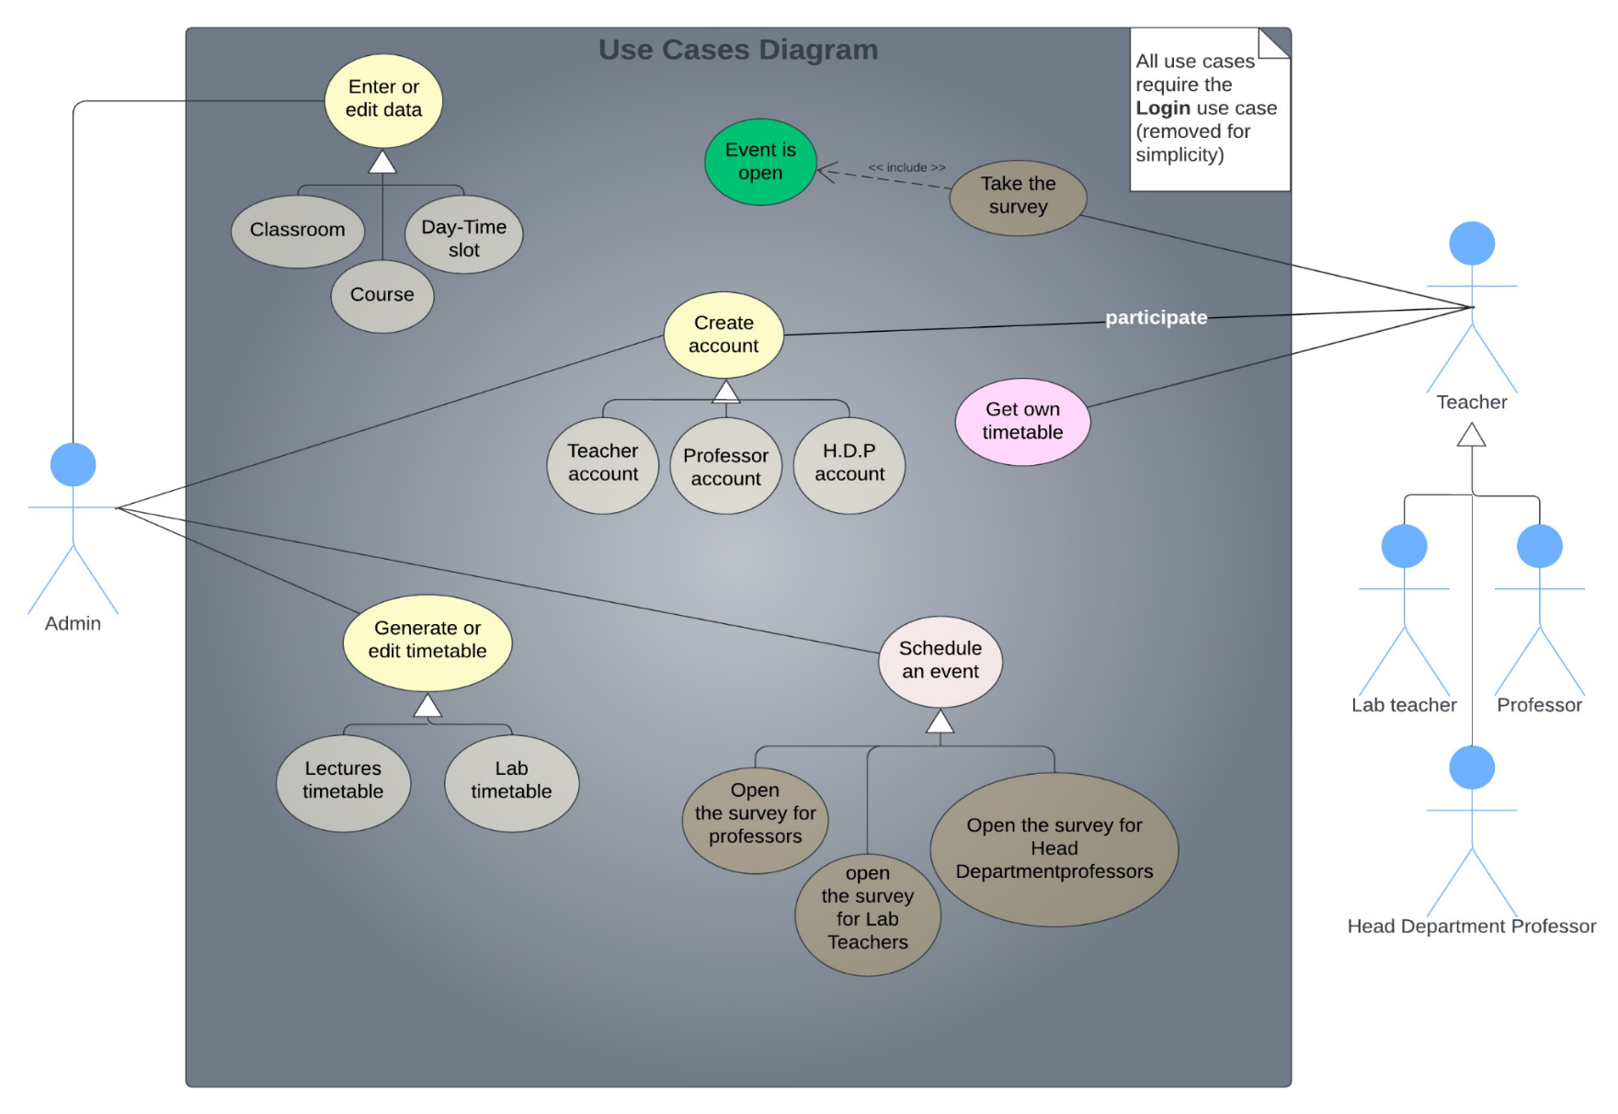
Use Cases diagram
5

Slide 6
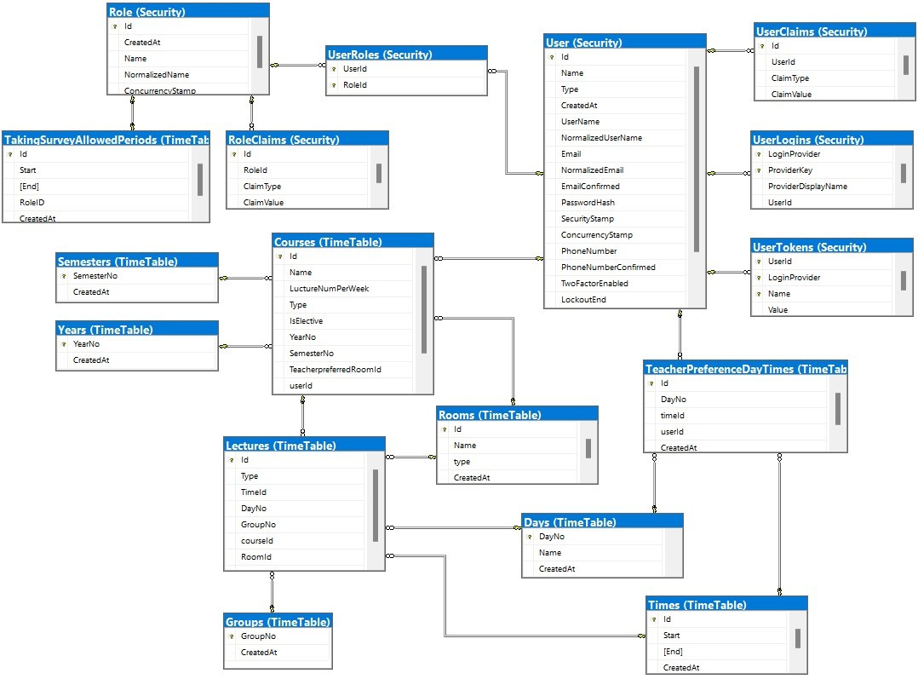
ERD diagram
6

Slide 7
Conclusions and Suggestions
Data Analysis : Utilize data analysis techniques to
understand student attendance patterns and preferences.
Smart Distribution System : Develop a system that
considers student and faculty requirements , distributing
schedules and courses in a balanced and fair manner.
7

Slide 8
We got
Clean, redundancy-free code by following the DRY principle in programming principles.
Portable and scalable code with the Dependency Inversion Principle.
A loosely coupled object-oriented system that is maintainable and testable by Dependency Injection technique.
Clear and understandable code by seeking Separation of Concerns design principle and applying some patterns like MVC.
Cross-platform program.
8

Slide 9
Suggestions
We will not just stop here, but on the contrary, we will seek for more in the future, so we will improve the system or correct errors and produce new versions of the system. Maybe:
The intelligent system has the potential to enhance the experience of
students and faculty.
The system is expected to improve time management efficiency.
Data analytics can assist the college in making informed strategic
decisions based on student attendance and performance.
.
9

Slide 10
References
MVC - MDN Web Docs Glossary: Definitions of Web-related terms | MDN. (2022, July 31). MDN. Retrieved August 6, 2022, from https://developer.mozilla.org/en-US/docs/Glossary/MVC
Genetic Algorithms tutorial. (n.d.). Tutorialspoint. https://www.tutorialspoint.com/genetic_algorithms/index.htm
Education, I. C. (2021, September 16). Three-Tier Architecture. IBM. Retrieved August 6, 2022, from https://www.ibm.com/cloud/learn/three-tier-architecture
Clean Coder Blog. (2012, August 13). Cleancoder. Retrieved August 6, 2022, from https://blog.cleancoder.com/uncle-bob/2012/08/13/the-clean-architecture.html
Design Patterns. (n.d.). DevIQ. Retrieved August 6, 2022, from https://deviq.com/design-patterns/design-patterns-overview/ Principles. (n.d.). DevIQ. Retrieved August 6, 2022, from https://deviq.com/principles/principles-overview/
10

Slide 11
Thank You

